Slide 1
Actuarial Predictive Modeling
Joe Warth ‘13

Slide 2
Agenda
Actuarial Universe (and where I fit in)
Basics of Pricing
Case Study: French Motor Liability Claims
Q&A

Slide 3


Actuarial Universe
International
United States
Property & Casualty
Pricing
Capital Modeling/ERM
Catastrophe Modeling
Reinsurance
Other
Personal Lines
Commercial Lines
General Liability
Commercial Property
Worker’s Compensation
Commercial Auto
Reserving
Everything Else
Data Science
Pricing Actuaries
Data Analysts
Product Management
Underwriting
IT / Deployment
Regulatory & Legal

Slide 4
Pricing 101: How the money flows
Customer asks Insurance Company for a promise: if I financially harm someone in the next __ months (usually 6 or 12), you pay the damages instead
Insurance Company charges Premium up front for the contract
The contract’s fundamental unit is called an Exposure
For Auto insurance, this is Car Months or Car Years
Cover 1 car for 6 months = 6 Car Months = 0.5 Car Years
Question: How many exposures if you cover 2 cars for 6 months?
If a damaging event occurs, this is called a Claim
This is the fundamental unit of loss
The amount of money it costs to resolve those damages is called the Loss
Insurance Company also has Expense (salaries, rent, etc.) that it pays just to operate
Remember: Premium, Exposure, Claim, Loss, Expense

Slide 5
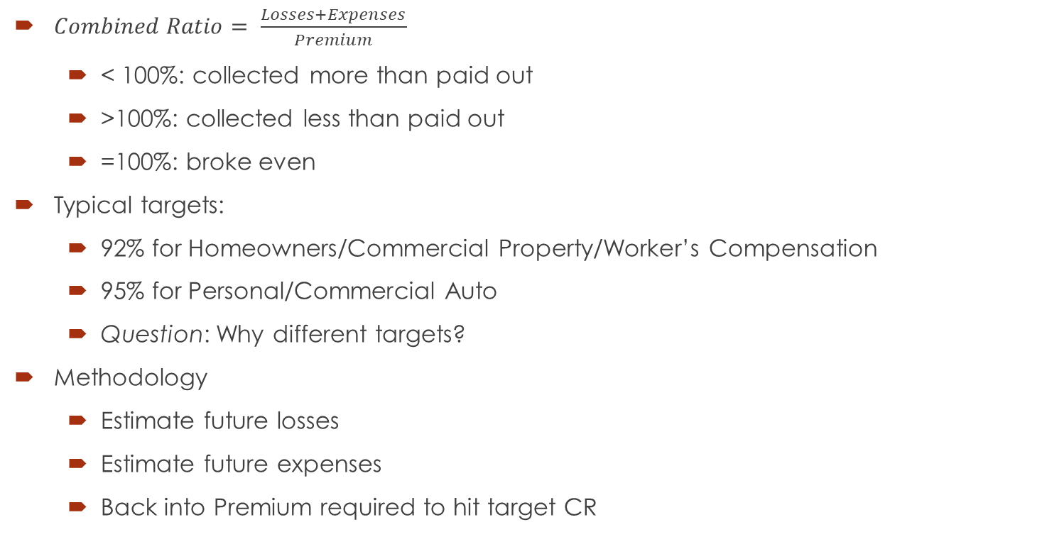
Basic Methodology: Combined Ratio
$Combined Ratio= \frac{Losses+Expenses}{Premium}$
< 100%: collected more than paid out
>100%: collected less than paid out
=100%: broke even
Typical targets:
92% for Homeowners/Commercial Property/Worker’s Compensation
95% for Personal/Commercial Auto
Question: Why different targets?
Methodology
Estimate future losses
Estimate future expenses
Back into Premium required to hit target CR

Slide 6
What Price To Charge?
Say we estimate our future Losses to be $650K, our future Expenses to be $300K and our target CR to be 95%.
Question: What should our Premiums be?
~$1 million
Question: Say we estimate our future Exposures will be 400. What should we charge for each Exposure?
Option 1: Charge everyone exactly $2,500 per exposure.
Question: Is that a good idea?
Option 2: On average charge $2,500 per exposure, but charge “good” customers less and “bad” customers more
How do I determine who is a “good” or “bad” customer?
How do I determine how much more or less to charge?
Why is this a better idea than Option 1?

Slide 7
Adverse Selection: A Simple Marketplace
Only two companies: Company A and Company B
Both companies have equal expenses, profit targets and equivalent customer satisfaction
Only two kinds of customers: Good and Bad
Good customers cost $2000 per exposure and Bad customers cost $3000 per exposure (including Losses, Expenses & Profit- numerator of the Combined Ratio)
80% of the market is a Good customer and 20% of the market is a Bad customer
Customers are rational and fully informed
 | Company A | Company B
Pricing | Flat $2200 per exposure (0.8 * 2000 + 0.2 * 3000) | $2000/exp for a Good customer and $3000/exp for a Bad customer
Customer Perception | Cheapest price available for all Bad customers | Cheapest price available for all Good customers
Outcome | Wins all Bad customers and loses $800/exp | Wins all Good customers and prices them appropriately

Slide 8
Case Study
French Motor Liability Claims

Slide 9
Appendix
Swiss Actuaries Actuarial Data Science Tutorials
We did Case Study 1 tonight
There are currently 16 case studies that explore actuarial data science topics and techniques
There is also a fantastic Data Sets log that can help you find datasets for your own projects

